Slide 1

AASD 4000
Machine Learning - I
Applied AI Solutions Developer Program

Slide 2
Lecture 01 Python Tutorial
Vejey Gandyer

Slide 3
Agenda
Operators
Data Structures
Conditional & Loop Statements
Functions
List Comprehensions
Iterators & Generators
Classes & Objects
Modules & Packages
Files

Slide 4
Operators

Slide 5
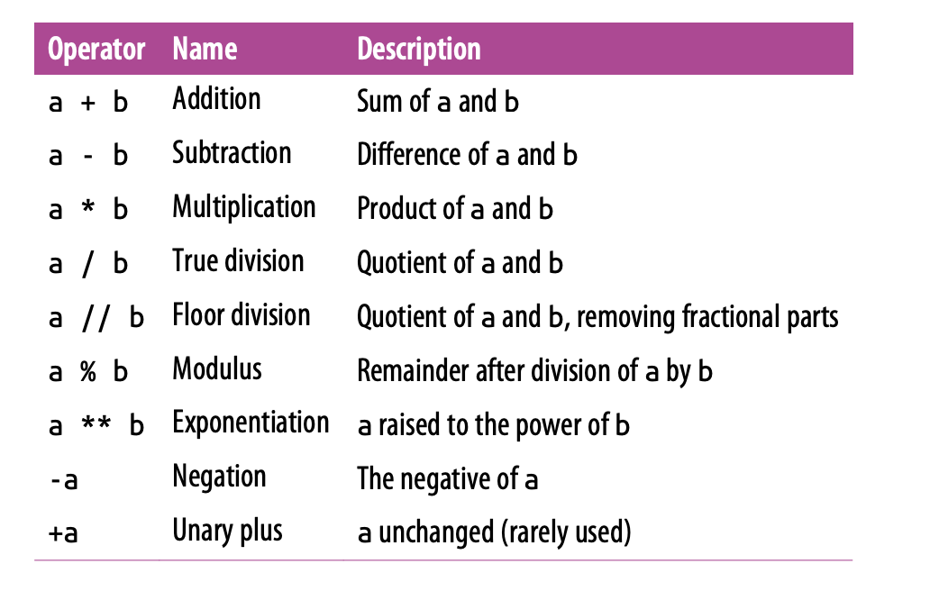
Arithmetic Operators
7 Binary Arithmetic Operators
2 Unary Arithmetic Operators
1 New Matrix Operator @
a @ b

Slide 6
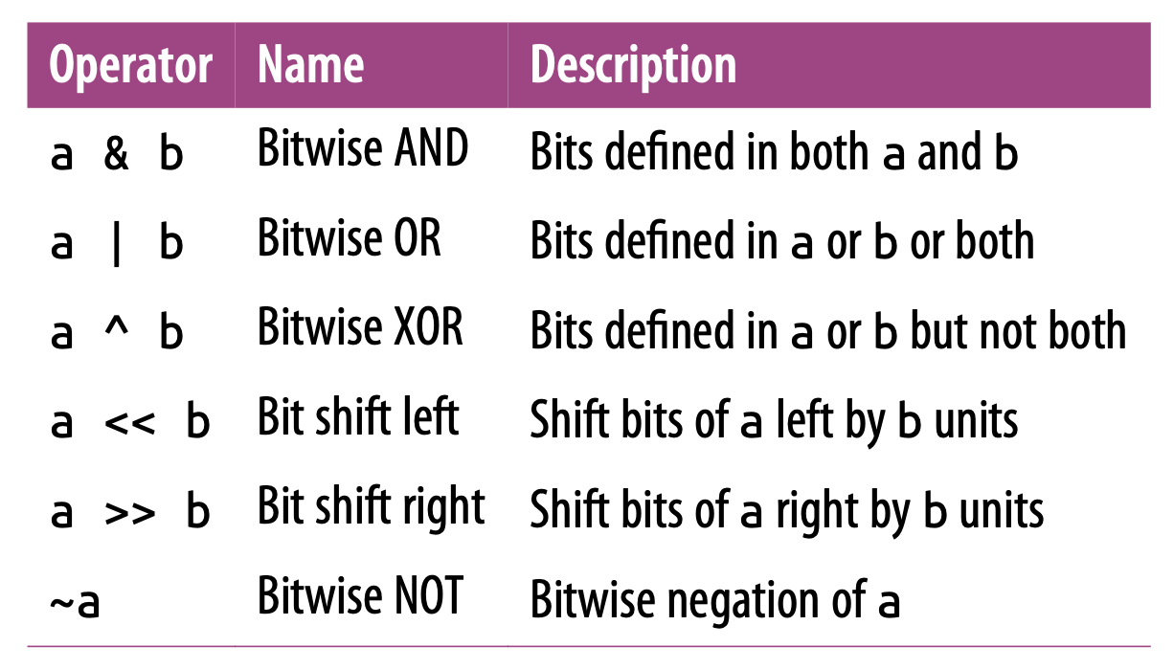
Bitwise Operators
6 Bitwise Operators
XOR ^ is confused with Exponentiation **

Slide 7
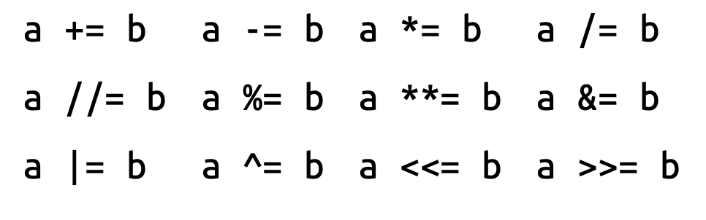
Assignment Operators
= operator
Single update and assignment

Slide 8
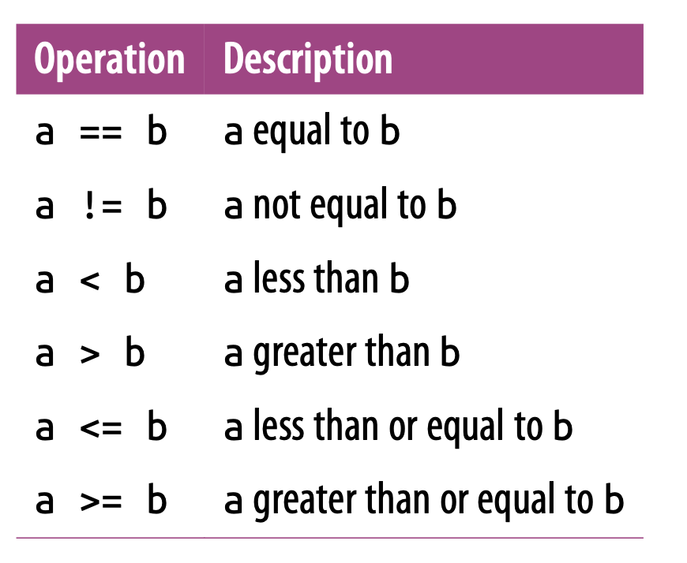
Comparison Operators
Returns Boolean values
True or False

Slide 9
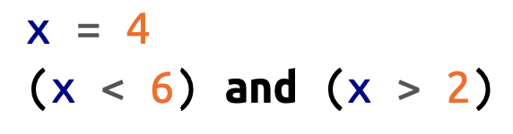


Boolean Operators
Confusion of when to use Boolean and Bitwise Operators

Slide 10
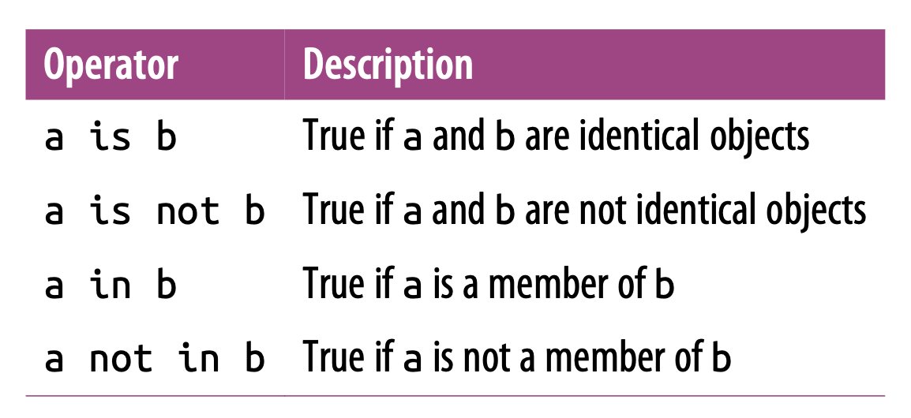
Identity and Membership Operators
Identity Operator: Checks object identity
Equality is different
Checks whether two objects (container) are same and not their values
Membership Operator: Checks for membership

Slide 11
Data Structures
Simple Types

Slide 12
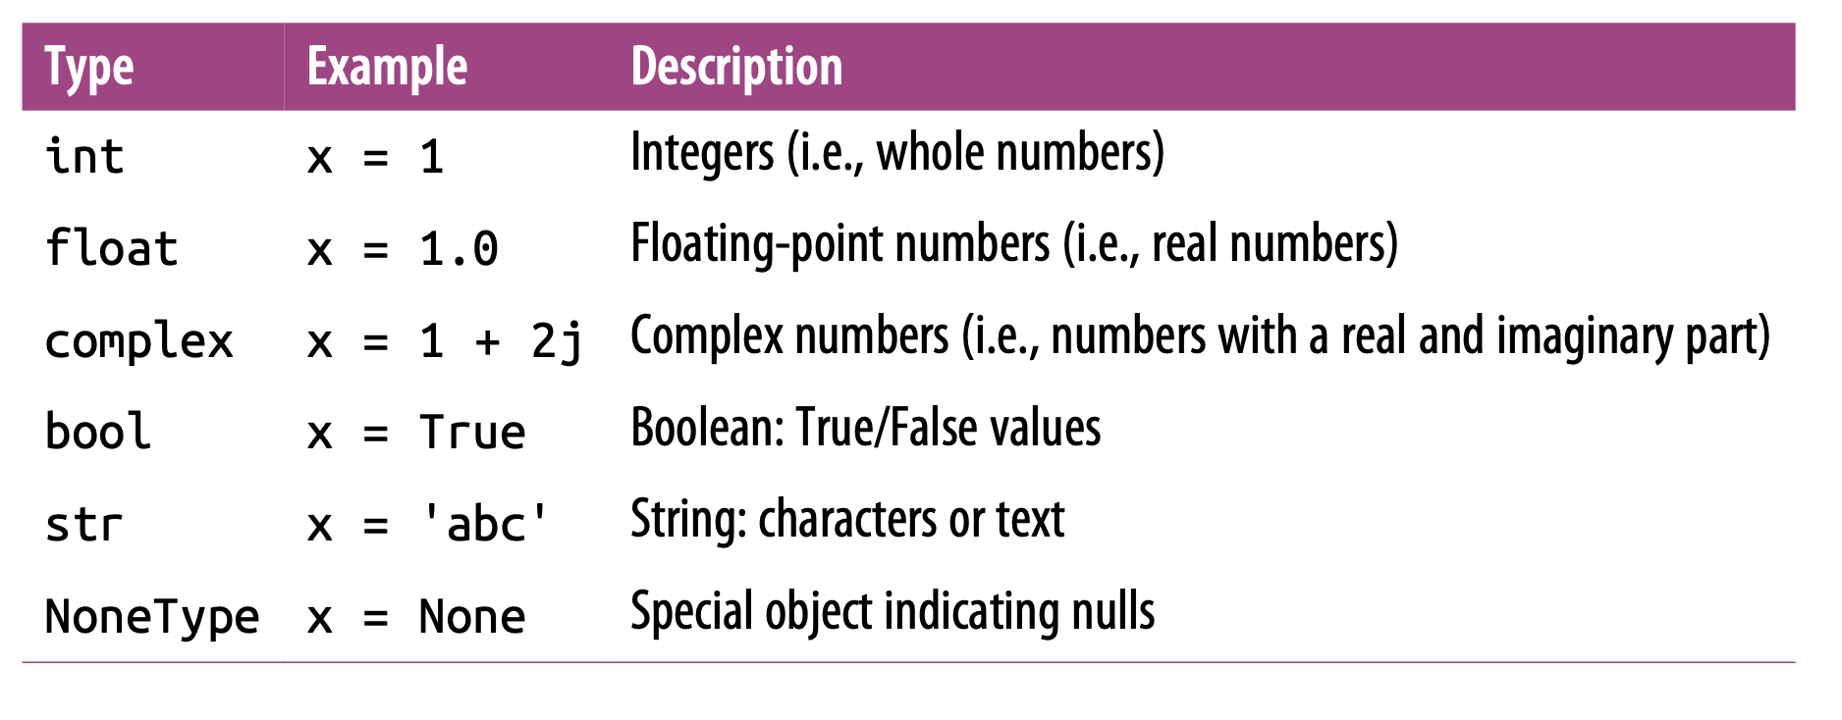
Simple Types
Identity Operator: Checks object identity
Equality is different
Checks whether two objects (container) are same and not their values
Membership Operator: Checks for membership

Slide 13

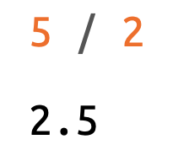
Integers
Variable-precision : Better Overflow Management than C, C++
Division Upcasting

Slide 14
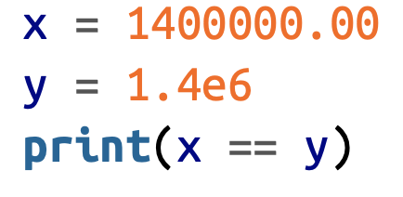
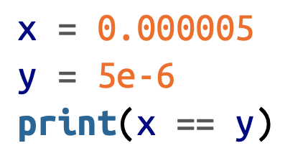
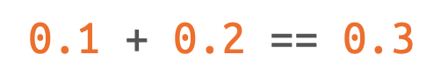
Floats
Defined both in decimal and exponential notation
Floating-point precision: rounding-off errors
Equality Tests

Slide 15






Complex
Contains both Real and Imaginary parts
Methods operating on Complex numbers

Slide 16







String Type
Several string manipulations are possible

Slide 17



None Type
NoneType has only one value: None
Default return value of a function eg: print()

Slide 18
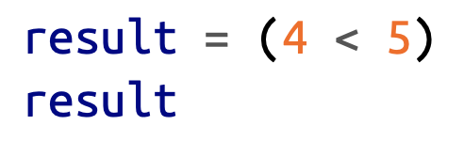





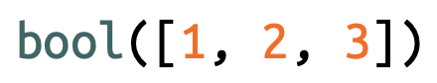
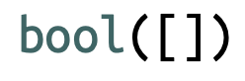
Boolean Type
Boolean Type has only two values: True & False
bool() constructor

Slide 19
Data Structures
Compound Types

Slide 20

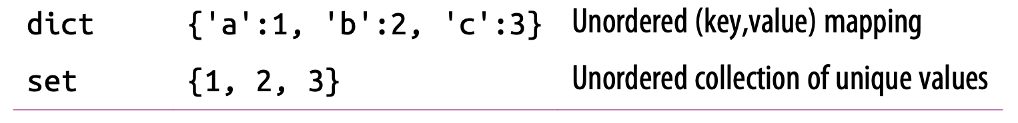
Compound Types
4 Compound Types
List - [ ]
Tuple - ( )
Dict - { }
Set - { }

Slide 21




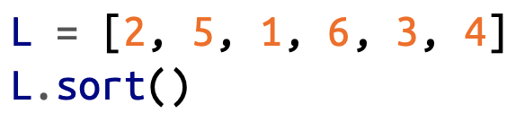

Lists
[ ]
Mutable data structure
Ordered data structure
Multi-type data structure

Slide 22



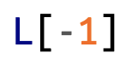
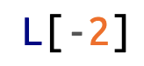
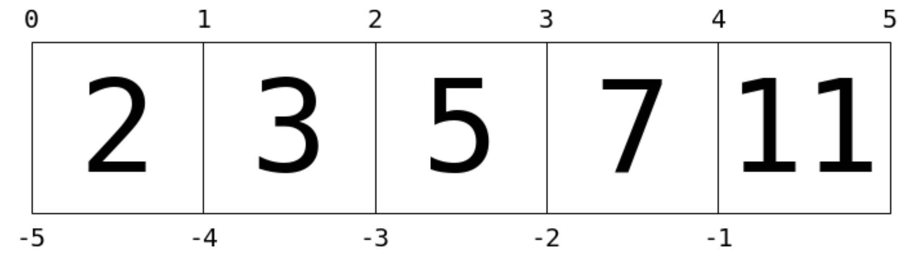





Lists: Indexing and Slicing
Indexing:
Zero-based
Accesses single values
Slicing:
Accesses multiple values

Slide 23




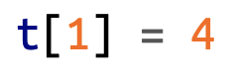

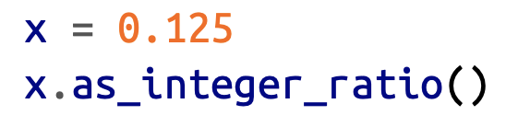
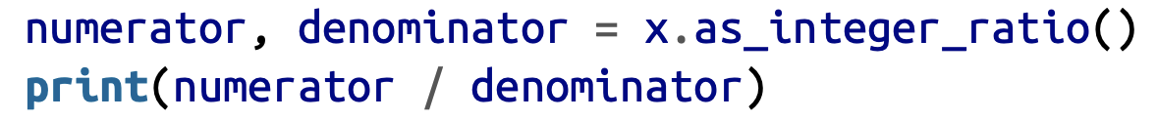
Tuples
( )
Immutable Data Structure
Used in Functions returning multiple return values

Slide 24

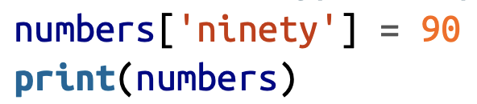
Dictionaries
{ }
Mutable Data Structure
Mappings of Keys and Values
Unordered Data Structure
Efficient Data Structure

Slide 25
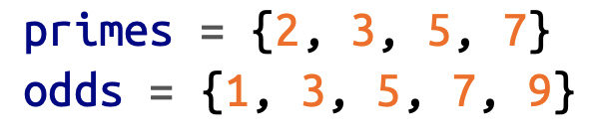
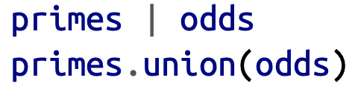
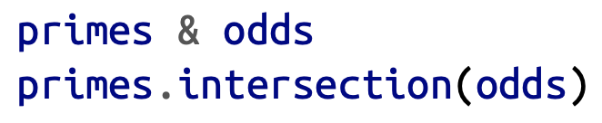
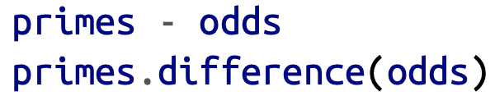
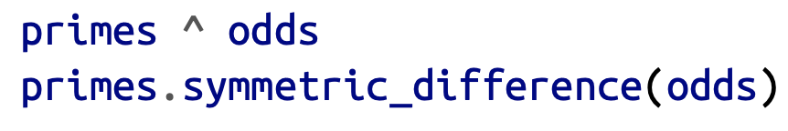
Sets
{ }
Unordered collection of unique items
Operations: Union, Intersection, Difference, Symmetric difference

Slide 26
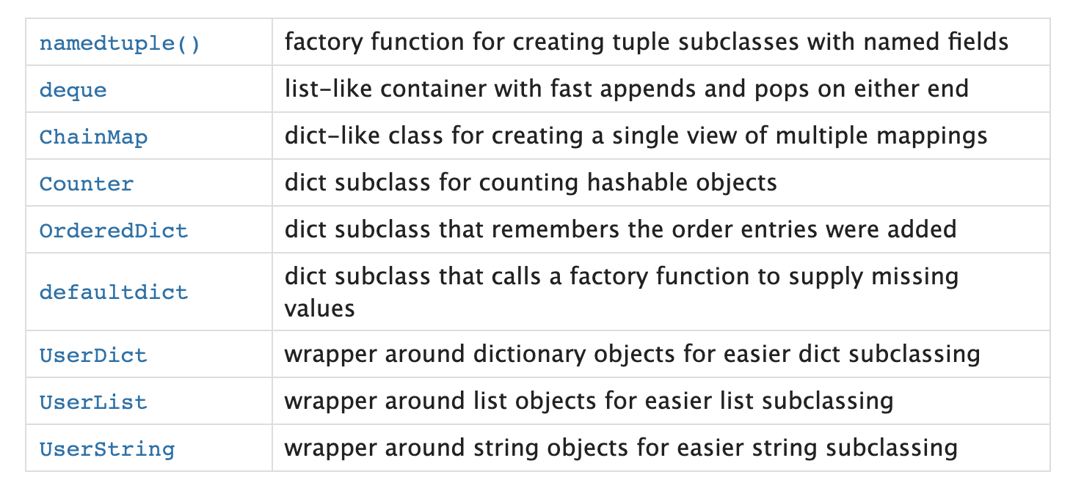
Collections
Powerful built-in collections
deque
OrderedDict
Counter
https://docs.python.org/3/library/collections.html

Slide 27
Conditional & Loop Statements

Slide 28
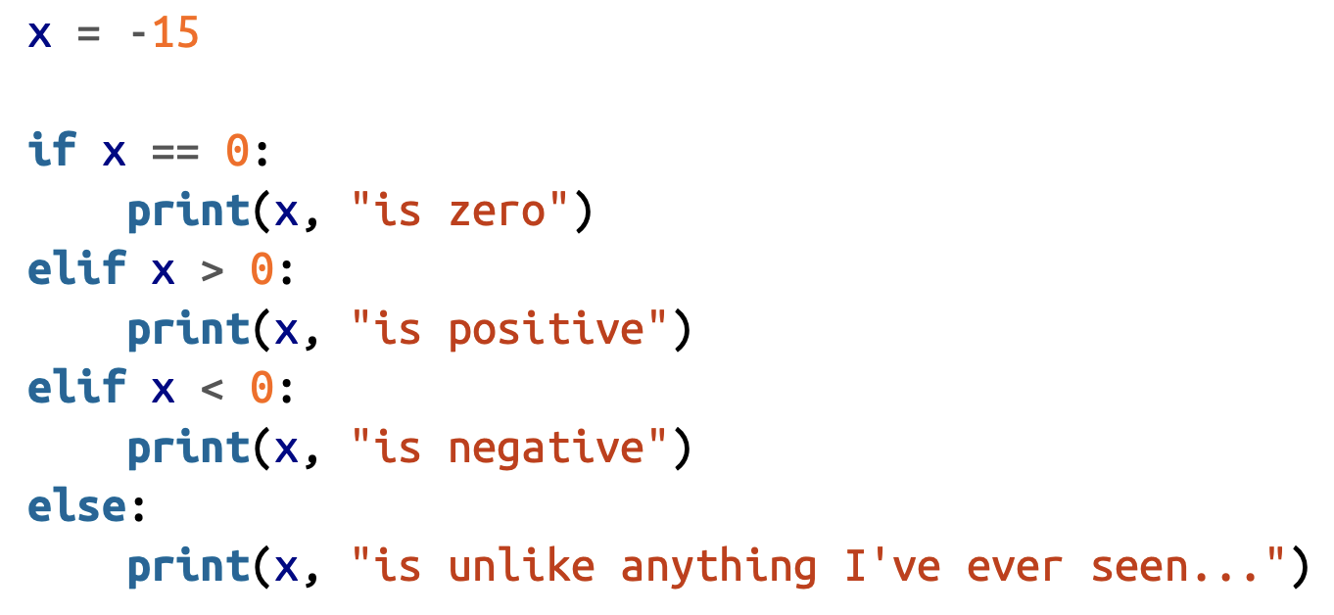
Conditional Statements
If-then statements
Unique elif
Executes a piece of code when a condition is met

Slide 29
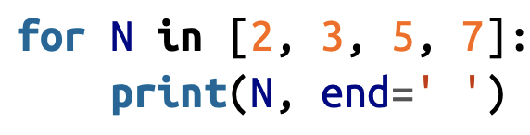
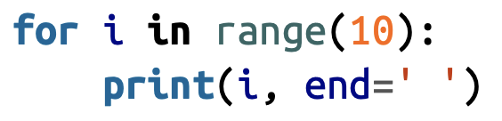

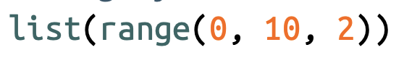
for loop
Executes some piece of code repeatedly
Variable to use
Sequence to loop over
in operator
Iterable object (range( ) )

Slide 30
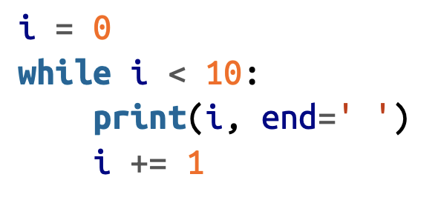
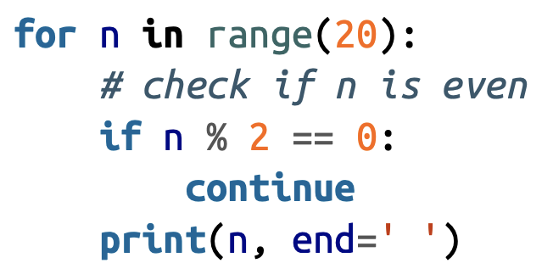
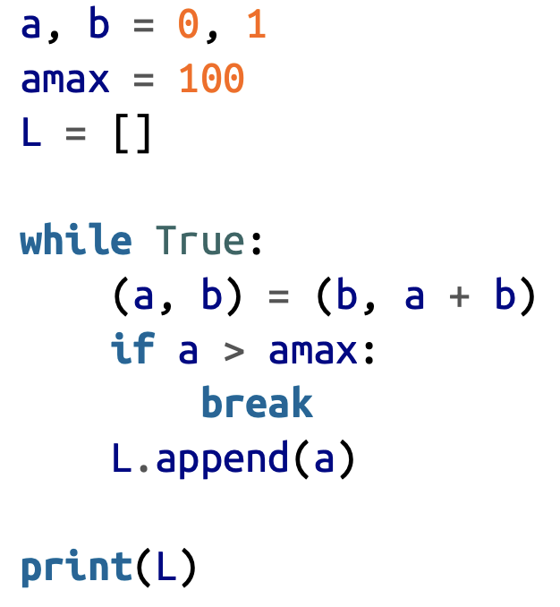
while loop
Executes some piece of code until condition is met
break: breaks out of the loop
continue: skips the remainder of current iteration and goes to next iteration
pass: goes to the next statement

Slide 31
Functions

Slide 32



Functions
def
Function name
Function arguments
Keyword arguments

Slide 33
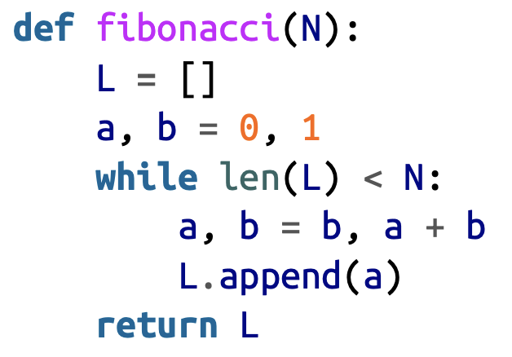

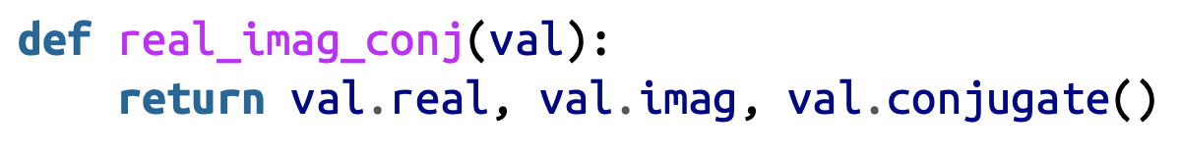
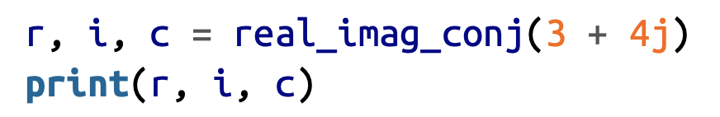
Defining Functions
Logic can be encapsulated within a reusable piece of code called function
Single or multiple return values are possible

Slide 34
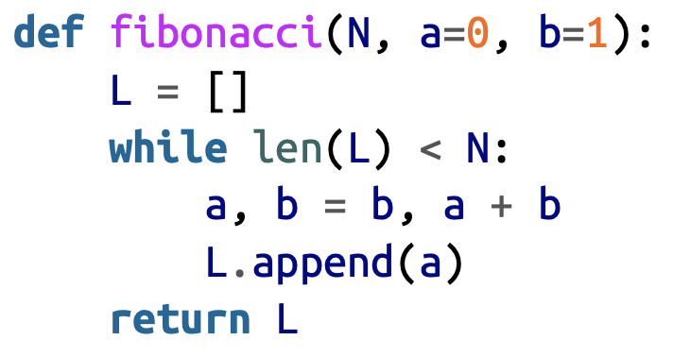

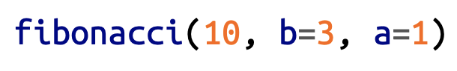
Default Arguments
Certain values should be used most of the times inside the logic of a function, but needs to give the user the flexibility

Slide 35
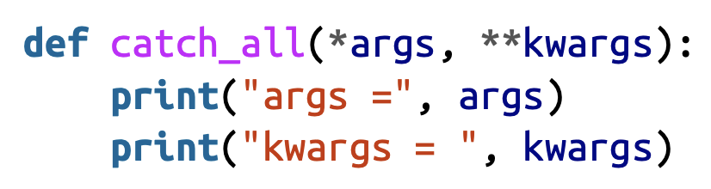

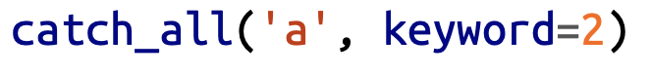
*args & **kwargs
Function with unknown number of arguments
*args: Arguments
Expand this as a Sequence
**kwargs: Keyword Arguments
Expand this as a Dictionary

Slide 36
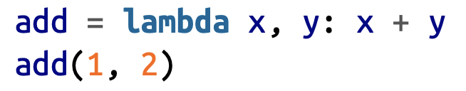
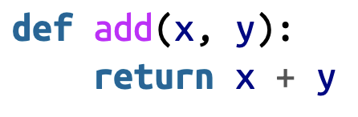
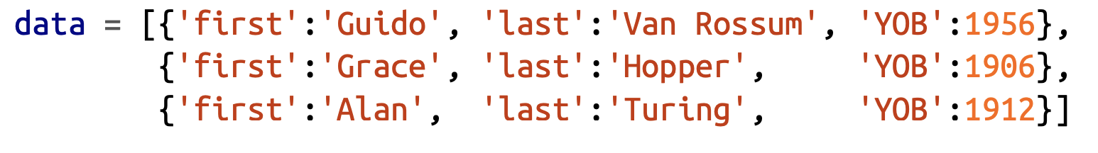

Lambda function

Slide 37
List Comprehensions

Slide 38
List Comprehensions
Compress a large set of for loop logic into one line
Pythonic way of writing a program

Slide 39
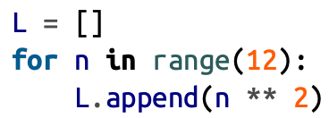
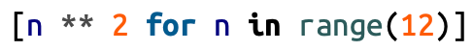
List Comprehensions
Construct a list comprehension for this logic

Slide 40
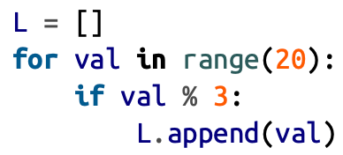
List Comprehensions

Slide 41
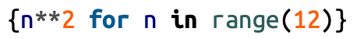

Set Comprehensions

Slide 42

Dict Comprehensions

Slide 43
Generators

Slide 44


List Comprehensions
Generator expression is a list comprehension in which elements are generated as needed rather than all at once
Generator Expressions

Slide 45
List Comprehensions Vs Generators
List comprehension is a collection of values
Memory is allocated when creating a list
Size of a list is limited
Can be iterated multiple times
Generator expression is a recipe for producing values
Memory is not allocated until it is asked for computation
Unlimited size
Only one iteration

Slide 46



Infinite number generator

Slide 47



Only one iteration
List Comprehension
Generator

Slide 48


yield - yields a sequence of values
List Comprehension
Generator

Slide 49
Classes & Objects

Slide 50


Classes & Objects
State : It is represented by attributes of an object. It also reflects the properties of an object.
Behavior : It is represented by methods of an object. It also reflects the response of an object with other objects.
Identity : It gives a unique name to an object and enables one object to interact with other objects

Slide 51













Classes & Objects
Class: code template for creating objects, created by keyword class
Objects: member variables and have behaviour associated with them, created using constructor of the class
Attributes: Properties inside a class
Methods: Operations on attributes

Slide 52




Inheritance
Inheritance: an object is based on another object, methods and attributes that were defined in the base class will also be present in the inherited class
Abstract away similar code in multiple classes
The abstracted code will reside in the base class and the previous classes will now inherit from the base class

Slide 53


Operator Overloading
Overloading of operators

Slide 54
Modules & Packages

Slide 55




Loading Modules
Explicit module import
Alias Explicit module import
Explicit import of module contents
Implicit import of module contents

Slide 56


Loading Modules
Import from Python Standard Library

Slide 57
Files

Slide 58
Open ()
Opens a file object
Mode
‘r’ – Read mode which is used when the file is only being read
‘w’ – Write mode which is used to edit and write new information to the file
‘a’ – Append mode, which is used to add new data to the end of the file
‘r+’ – Special read and write mode, which is used to handle both actions when working with a file

Slide 59

Creating a file
Create a file
Write contents to a file

Slide 60


Reading a file
read
readlines

Slide 61


Writing a file
write
writelines

Slide 62

Appending a file
append

Slide 63


with
with read
with write

Slide 64


with
with readlines
with splitting

Slide 65
References & Further Reading
Images used in the deck is credited to these resources
- A whirlwind tour of Python Jake Vanderplas
- Learn Python the hard way Zed Shaw
- Python Crash Course: A Hands-On, Project-Based Introduction to Programming Eric Matthes
For more Python practice and get upto speed, look at the attached Python Notebooks for practice [Optional]

Slide 66
Jupyter Notebook

Slide 67
Jupyter Notebook
https://jupyter-notebook-beginner-guide.readthedocs.io/en/latest/what_is_jupyter.html
Let's take a tour

Slide 68
Task 1: Python script for Web Scraping

Slide 69
Task 1
Create a Python script for enabling web scraping.
Input: Url (medium article)
Output: File stored in your local machine with the text from the url
Hints: You require the following libraries to accomplish that.
os - File storing in the local directory of your machine
requests - Used for sending requests with url as input and get html source as response
beautifulSoup - Used in parsing the html source response and make sense
Import library
Study the library usage in its documentation
Fill in the blank provided in the Script
Submit the extracted and stored file containing the text under Assignment 1

Slide 70
Task 2: Push files in Github
Replicate Task 1 in a Jupyter Notebook and push file into Github account

Slide 71
Task 2
Replicate the answer from the previuos Python script for enabling web scraping into a Jupyter Notebook. Push these three files (text file, python script and notebook) into your Github account.
Input(s): Text (.txt), Python script (.py) and Notebook (.ipynb)
Output: Github account with these three files pushed, reviewed and merged into the master branch of your repo
Hints: You require the following to accomplish that.
python script - Task 1 answer (.py)
Text file - Task 1 text file (.txt)
Notebook - Replicated answer in a notebook file (.ipynb)
Github repo - Your repo that you have created already
Choose one of your classmate and add him/her as a collaborator in your Repo's settings
Commit, Push, Create a PR with a Reviewer
Wait for approval, Merge
Submit the repo link as the submission file for Task 2

